Slide 1
Chapter 7
How to work with lists, links, and navigation menus

Slide 2
Objectives
Applied
Create links and lists in all their variations with HTML and with CSS.
Knowledge
Name and describe the three types of HTML lists.
Describe the use of <a> elements for linking to another web page, opening another web page in a new browser window, linking to placeholders on the same page, linking to media files, starting an email message, calling a phone number, or starting a Skype session.
Describe the use of unordered lists and <a> elements for the creation of navigation lists and navigation menus, including 2- and 3-tier menus.
Describe the use of these pseudo-classes for formatting links: :link, :visited, :hover, and :focus.
Describe the use of these CSS properties for formatting links: text-decoration and border.

Slide 3
HTML for an unordered list with paragraphs and links
<h1>San Joaquin Valley Town Hall Programs</h1>
<ul>
<li>
<p>Join us for a complimentary coffee hour at the
<a href="saroyan.html">William Saroyan Theatre</a>, 9:15 to 10:15
a.m. on the day of each lecture. The speakers usually attend this very special event.</p>
</li>
<li>
<p>Extend the excitement of Town Hall by purchasing tickets to the post-lecture luncheons. This unique opportunity allows you to ask
more questions of the speakers--plus spend extra time meeting new Town Hall friends.</p>
<p>A limited number of tickets are available. Call (559) 555-1212 for reservations by the Friday preceding the event.</p>
</li>
</ul>

Slide 4
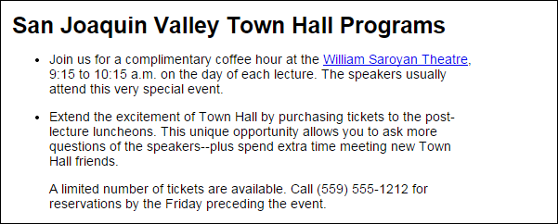
The unordered list in a web browser

Slide 5
An ordered list that is continued
<h1>How to use the WinZip Self Extractor</h1>
<h2>Before you start the WinZip Self Extractor</h2>
<ol>
<li>Create a text file that contains the message you want to be displayed when the executable starts.</li>
<li>Create a batch file that copies the exercises, and store it in the main folder for the files to be zipped.</li>
<li>Create the zip file.</li>
</ol>
<h2>How to create an executable file</h2>
<ol start="4">
<li>Run the WinZip Self Extractor program and click through the first three dialog boxes.</li>
<li>Enter the name of the zip file in the fourth dialog box.</li>
<li>Click the Next button to test the executable.</li>
</ol>

Slide 6
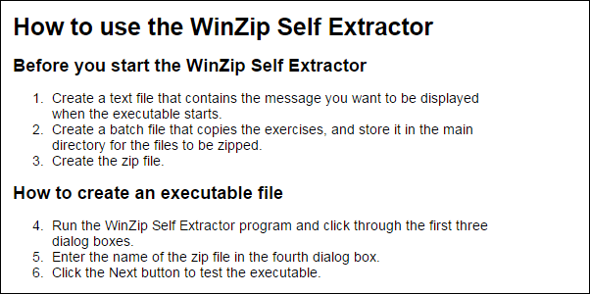
The ordered list in a web browser

Slide 7
Ordered lists nested within an unordered list
<h1>How to use the WinZip Self Extractor program</h1>
<ul>
<li>Before you start the WinZip Self Extractor
<ol>
<li>...</li>
<li>...</li>
<li>...li>
</ol>
</li>
<li>How to create an executable file
<ol start="4">
<li>...li>
<li>...</li>
<li>...li>
</ol>
</li>
</ul>

Slide 8
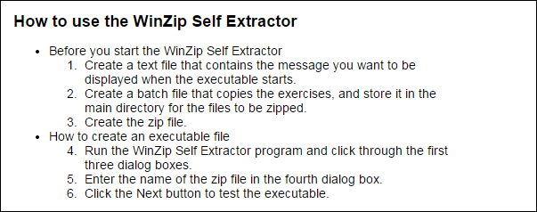
The nested lists in a web browser

Slide 9
HTML for a description list
<h2>Components of the Internet architecture</h2>
<dl>
<dt>client</dt>
<dd>A computer that accesses the web pages of a web application using a web browser.</dd>
<dt>web server</dt>
<dd>A computer that holds the files for each web application.</dd>
<dt>local area network (LAN)</dt>
<dd>A small network of computers that are near each other and can communicate with each other over short distances.</dd>
<dt>wide area network (WAN)</dt>
<dd>A network that consists of multiple LANs that have been connected together over long distances using routers.</dd>
<dt>Internet exchange point</dt>
<dd>Large routers that connect WANs together.</dd>
</dl>

Slide 10
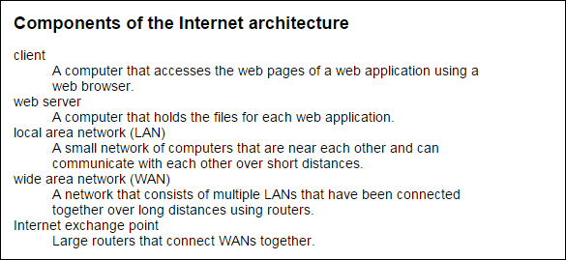
The description list in a web browser

Slide 11
Properties for formatting unordered lists
list-style-type
list-style-image
Values for the list-style-type property of an unordered list
disc
circle
square
none

Slide 12
HTML for two unordered lists
<h2>Popular web browsers include</h2>
<ul class="circle">
<li>Internet Explorer</li>
<li>Firefox</li>
<li>Chrome</li>
</ul>
<h2>Prime skills for web developers are</h2>
<ul class="star">
<li>HTML5 and CSS3</li>
<li>JavaScript</li>
<li>PHP</li>
</ul>
CSS that changes the bullets
ul.circle { list-style-type: circle; }
ul.star { list-style-image: url("../images/star.png"); }

Slide 13
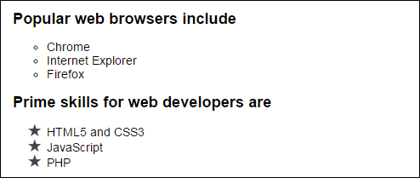
The bullet changes in a web browser

Slide 14
Common values for the list-style-type property of an ordered list
decimal
decimal-leading-zero
lower-alpha
upper-alpha
lower-roman
upper-roman

Slide 15
HTML for an ordered list
<h2>How to create an executable file</h2>
<ol class="lower_alpha">
<li>Run the WinZip Self Extractor program and click through the first three dialog boxes.</li>
<li>Enter the name of the zip file in the fourth dialog box.</li>
<li>Click the Next button to test the executable.</li>
</ol>
CSS that formats the list
ol.lower_alpha { list-style-type: lower-alpha; }

Slide 16
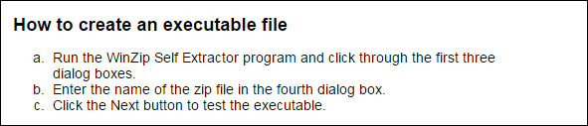
The ordered list changes in a web browser

Slide 17
HTML for an unordered list
<h2>Popular web browsers</h2>
<ul>
<li>Chrome</li>
<li>Internet Explorer</li>
<li>Firefox</li>
<li>Safari</li>
<li>Opera</li>
</ul>
CSS that aligns the list items
h2, ul, li {
margin: 0;
padding: 0;
}
ul { padding-left: 1em;
}
li {
padding-left: .25em;
padding-bottom: .25em;
}

Slide 18
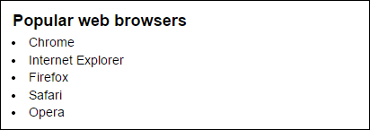
The aligned list items in a web browser

Slide 19
Four attributes of the <a> element
href
title
tabindex
accesskey

Slide 20
A text link, an image link, and a text link with a title attribute
<p>
<a href="/orders/cart.html" accesskey="c" tabindex="0">Shopping cart</a>
<a href="/orders/cart.html"> <img src="images/cart_animated.gif"
alt="Shopping cart"></a>
</p>
<p><a href="/books/php_toc.html"
title="Review the complete table of contents">TOC</a></p>

Slide 21
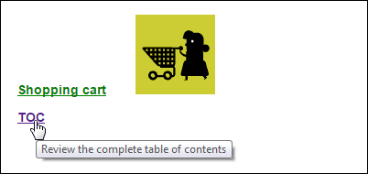
The text and image links in a web browser

Slide 22
Accessibility guidelines for links
If the text for a link has to be short, code the title attribute to clarify where the link is going.
You should also code the title attribute if a link includes an image with no text.

Slide 23
Common CSS pseudo-classes for formatting links
:link
:visited
:hover
:focus
:active

Slide 24
The properties for removing underlines and borders
text-decoration
border-style

Slide 25
The HTML for three links
<ul>
<li><a href="toobin.html">Jeffrey Toobin</a></li>
<li><a href="sorkin.html">Andrew Ross Sorkin</a></li>
<li><a href="chua.html">Amy Chua</a></li>
</ul>
The CSS for pseudo-class selectors that apply to the links
a:link {
color: green;
}
a:hover, a:focus {
text-decoration: none;
font-size: 125%;
}

Slide 26

The links in a browser with the focus on the third link

Slide 27
Accessibility guideline for :hover and :focus
Apply the same formatting for the :hover and :focus selectors.
That way, the formatting is the same whether you hover the mouse over a link or use the keyboard to tab to the link.

Slide 28
HTML for a link that loads the document in a new window or tab
<p>Just go to
<a href="http://www.html5test.com/" target="_blank">
the HTML5 testing site</a>. It rates your browser as it loads the page and also has data on how well other browsers conform to HTML5.
</p>

Slide 29
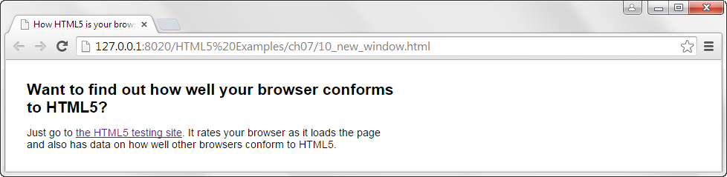
The HTML in one browser tab

Slide 30
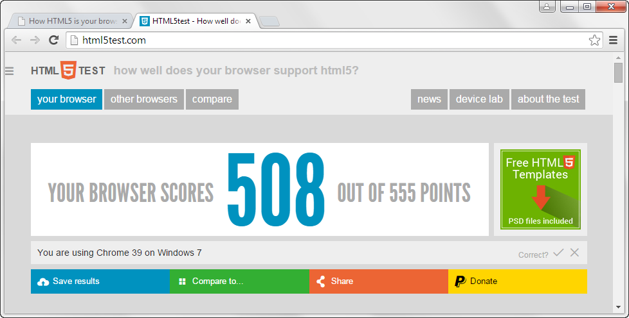
The html5test.com home page in another tab

Slide 31
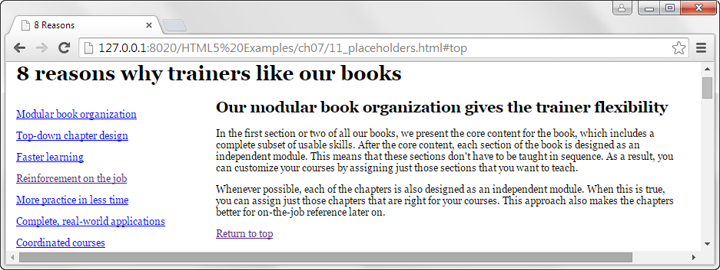
A web page that links to topics on the same page

Slide 32
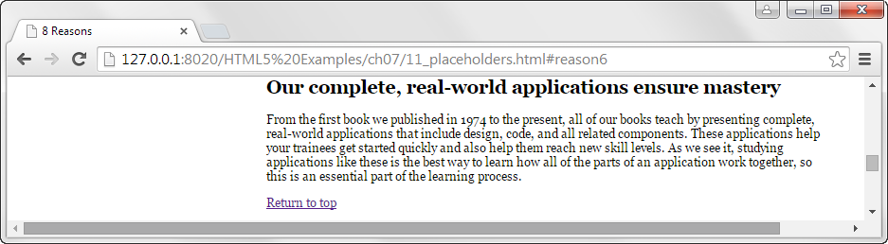
The page when the sixth link is clicked

Slide 33
Linking to placeholders on a page
The placeholder the top of the page
<h1><a id="top">8 reasons why trainers like our books</a></h1>
The placeholder for reason 6
<h2><a id="reason6">Our complete, real-world applications ensure mastery</a></h2>
Two links that jump to placeholders on the same page
<p><a href="#reason6">Complete, real-world applications</a></p>
<p><a href="#top">Return to top</a></p>
A link that jumps to a placeholder on this page from another page
<a href="8reasons.html#reason6">Complete, real-world applications</a>

Slide 34
Popular media formats
PDF
WAV
MP3
MPG/MPEG

Slide 35
An HTML link that displays a PDF file in a new window
<a href="documents/instructors_summary.pdf"
type="application/pdf"
target="_blank">Read the Instructor's Summary<a>

Slide 36
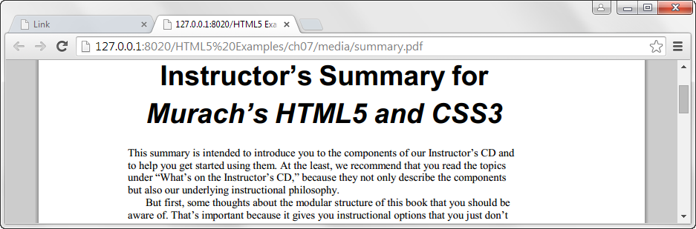
The PDF file in a browser

Slide 37
An HTML link that plays an MP3 file
<a href="music/twist_away.mp3" type="audio/mpeg"> MP3 file</a>

Slide 38
An HTML link that plays a PowerPoint slide show
<a href="media/chapter_01.pps"
target="_blank">Review the slides for chapter 1</a>

Slide 39

A web page with links for email, phone, and Skype

Slide 40
Email, phone, and Skype links
A link that starts an email message
<a href="mailto:support@murach.com">Send us an email</a>
An email link with a CC address and a subject
<a href="mailto:support@murach.com?cc=ben@murach.com &subject=Web mail">Send us an email</a>
A link that calls a phone number
<a href="tel:555-555-5555">Call us</a>
A link that starts a Skype session
<a href="skype:murachsupport">Skype chat with us</a>

Slide 41
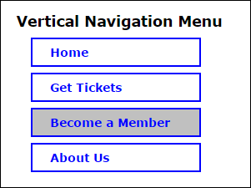
A vertical navigation menu

Slide 42
The HTML for the vertical navigation menu
<nav id="nav_list">
<ul>
<li><a href="index.html">Home</a></li>
<li><a href="tickets.html">Get Tickets</a></li>
<li><a href="members.html" class="current">Become a Member</a></li>
<li><a href="about_us.html">About Us</a></li>
</ul>
</nav>

Slide 43
The CSS for the vertical navigation menu
* { margin: 0;
padding: 0; }
#nav_menu_1 ul {
list-style-type: none;
margin-left: 1.25em;
margin-bottom: 1.5em; }
#nav_menu_1 ul li {
width: 200px;
margin-bottom: .5em;
border: 2px solid blue; }
#nav_menu_1 ul li a {
display: block;
padding: .5em 0 .5em 1.5em;
text-decoration: none;
font-weight: bold;
color: blue; }
#nav_menu_1 ul li a.current {
background-color: silver; }

Slide 44
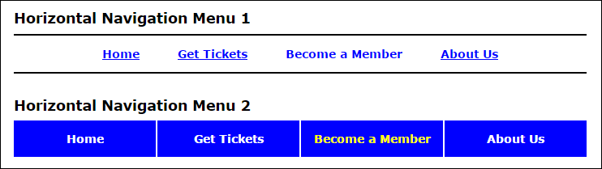
Two horizontal navigation menus

Slide 45
The HTML for the horizontal navigation menus
<nav id="nav_menu">
<ul>
<li><a href="index.html">Home</a></li>
<li><a href="tickets.html">Get Tickets</a></li>
<li><a href="members.html" class="current">Become a Member</a></li>
<li><a href="about_us.html" class="lastitem">About Us</a></li>
</ul>
</nav>

Slide 46
The CSS for the first horizontal menu
#nav_menu ul {
list-style-type: none;
padding: 1em 0; /* padding above and below li elements */
text-align: center;
border-top: 2px solid black;
border-bottom: 2px solid black; }
#nav_menu ul li {
display: inline;
padding: 0 1.5em; }
#nav_menu ul li a {
font-weight: bold;
color: blue; }
#nav_menu ul li a.current { text-decoration: none; }

Slide 47
The CSS for the second horizontal menu
#nav_menu ul { list-style-type: none; }
#nav_menu ul li { float: left; }
#nav_menu ul li a {
text-align: center;
display: block;
width: 175px;
padding: 1em 0; /* padding above and below a elements */
text-decoration: none;
background-color: blue;
color: white;
font-weight: bold;
border-right: 2px solid white; }
#nav_menu ul li a.lastitem { border-right: none; }
#nav_menu ul li a.current { color: yellow; }

Slide 48
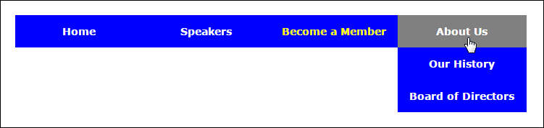
A 2-tier navigation menu

Slide 49
The HTML for the 2-tier menu
<nav id="nav_menu">
<ul>
<li><a href="index.html">Home</a></li>
<li><a href="#">Speakers</a>
<ul>
<li><a href="#">Jeffrey Toobin</a></li>
<li><a href="#">Andrew Ross Sorkin</a></li>
...
</ul>
</li>
<li><a href="members.html" class="current">Become a Member</a></li>
<li class="lastitem"><a href="aboutus.html">About Us</a>
<ul>
<li><a href="#">Our History</a></li>
<li><a href="#">Board of Directors</a></li>
</ul>
</li>
</ul>
</nav>

Slide 50
The CSS for the 2-tier menu
#nav_menu ul {
list-style: none;
position: relative;
}
#nav_menu ul li { float: left;
}
#nav_menu ul ul {
display: none;
position: absolute;
top: 100%;
}
#nav_menu ul ul li { float: none;
}
#nav_menu ul li:hover > ul {
display: block;
}
#nav_menu > ul::after {
content: "";
display: block;
clear: both;
}

Slide 51
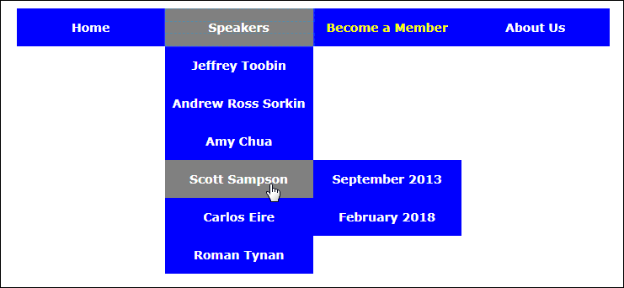
A 3-tier navigation menu

Slide 52
The HTML for the 3-tier menu
<nav id="nav_menu">
<ul>
<li><a href="index.html">Home</a></li>
<li><a href="speakers.html">Speakers</a>
<ul>
<li><a href="#">...</a></li>
<li><a href="#">...</a></li>
<li><a href="#">...Chua</a></li>
<li><a href="sampson.html">...</a>
<ul>
<li><a href="#">...</a></li>
<li><a href="#">...</a></li>
</ul>
</li>
<li><a href="#">...</a></li>
<li><a href="#">...</a></li>
</ul>
</li>
<li><a href="members.html">Become...</a></li>

Slide 53
The HTML for the 3-tier menu (continued)
<li class="lastitem"><a href="aboutus.html"> About Us</a>
<ul>
<li><a href="#">Our History</a></li>
<li><a href="#">Board...</a></li>
<li><a href="#">Past Speakers</a>
<ul>
<li><a href="#">2017</a></li>
<li><a href="#">2016</a></li>
<li><a href="#">2015</a></li>
</ul>
</li>
<li><a href="#"> Contact Information</a></li>
</ul>
</li>
</ul>
</nav>

Slide 54
The CSS for the operation of the 3-tier menu
#nav_menu ul {
list-style-type: none;
position: relative; }
#nav_menu ul li { float: left; }
#nav_menu ul ul {
display: none;
position: absolute;
top: 100%; }
#nav_menu ul ul li {
float: none;
position: relative; }
#nav_menu ul ul li ul {
position: absolute;
left: 100%;
top: 0; }
#nav_menu ul li.lastitem ul li ul {
position: absolute;
left: -100%;
top: 0; }
#nav_menu ul li:hover > ul { display: block; }
#nav_menu > ul::after {
content: "";
clear: both;
display: block; }

Slide 55
The CSS for formatting the 3-tier menu
#nav_menu ul {
margin: 0;
padding: 0; }
#nav_menu ul li a {
text-align: center;
display: block;
width: 176px;
padding: 1em 0;
text-decoration: none;
background-color: blue;
color: white;
font-weight: bold; }
#nav_menu ul li.lastitem a {
width: 178px; }
#nav_menu ul li a.current {
color: yellow; }
#nav_menu ul li a:hover, #nav_menu ul li a:focus {
background-color: gray; }

Slide 56
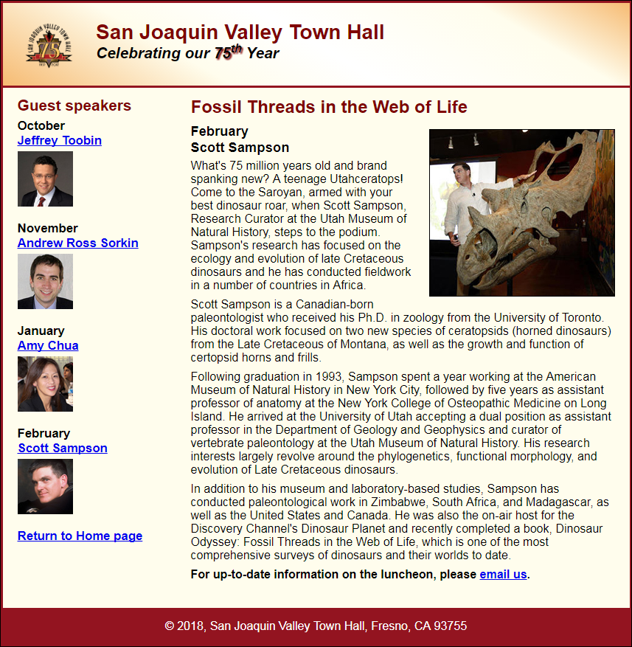
Short 7-1 Start an email

Slide 57
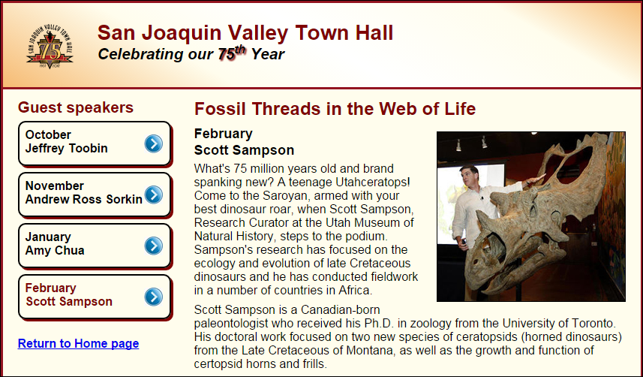
Short 7-2 Create a vertical navigation menu

